Slide 1
"Big data is not about the data, but about the insights it provides."
- Mark van Rijmenam

Slide 2
R Shiny for Big Data Visualization and Analysis
Siddhi Jadhav
23070243047

Slide 3
CONTENTS
What is R shiny?
R shiny and big data
Structure of Rshiny
Hands On
Conclusions

Slide 4
Web applications without html/css/js?
Shiny provides a range of built-in widgets and layouts for creating interactive elements such as sliders, dropdown menus, and interactive plots

Slide 5
What is shiny?
RShiny is an open-source web application framework in R language, designed for creating interactive, web-based data visualizations and dashboards. It allows users to develop customized, interactive applications without requiring expertise in web development.

Slide 6
FEATURES
REACTIVITY meaning that outputs automatically update in response to changes in inputs.
USER INTERFACE (UI) COMPONENTS: Shiny provides a variety of UI components such as sliders, input fields, checkboxes, buttons, and tabs .
SERVER-SIDE R CODE: Shiny applications consist of both a user interface (UI) component and
a server component, also written in R, which defines the logic behind the app's behavior.

Slide 7
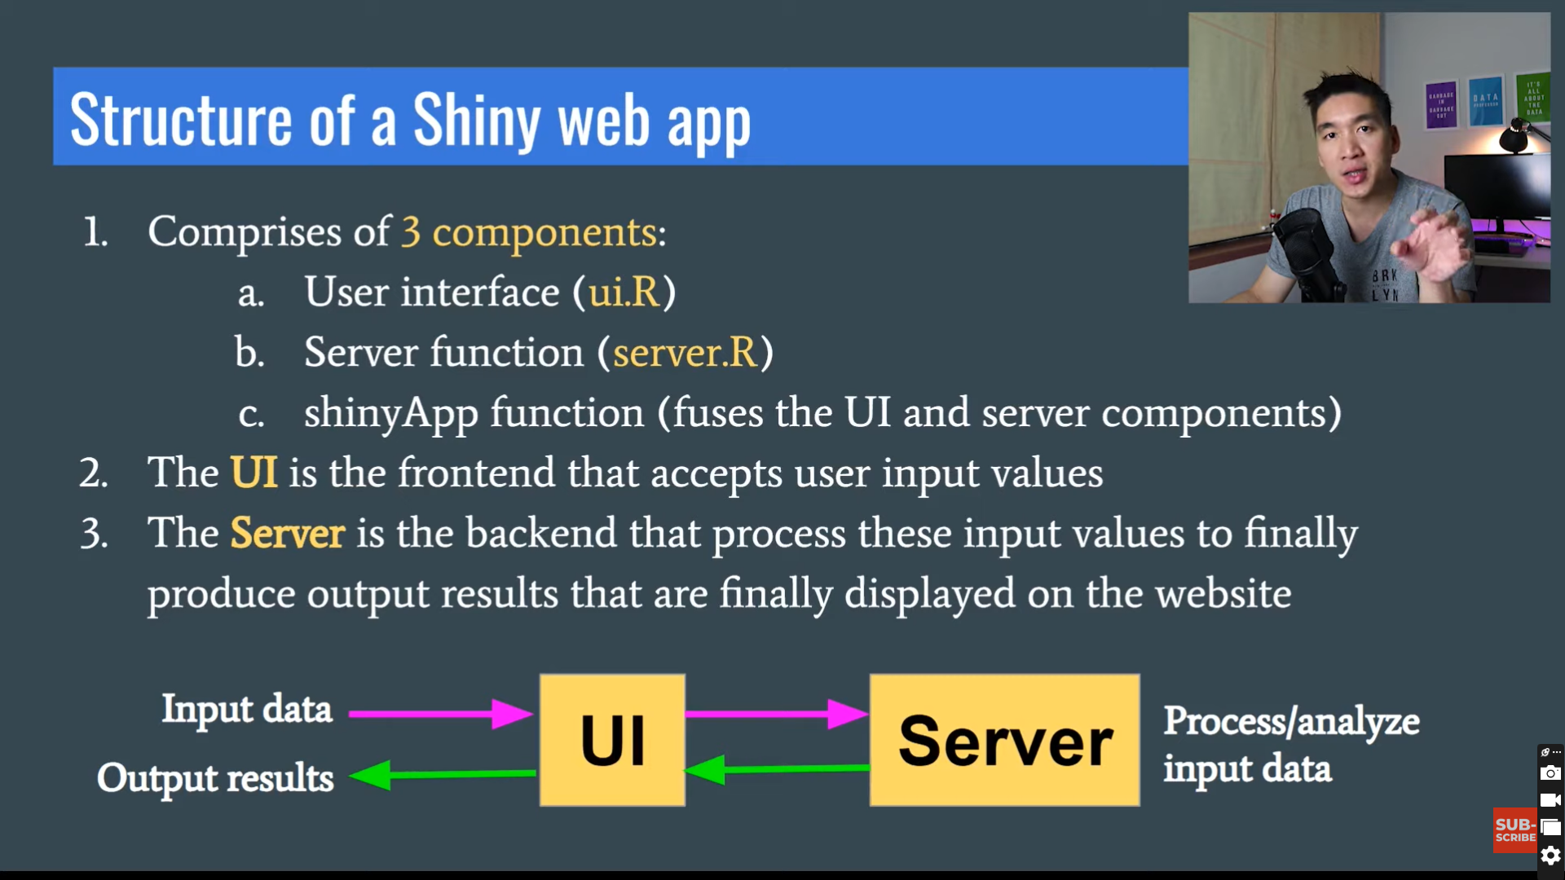
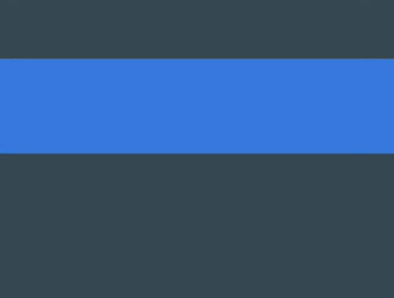

Slide 8
Structure of a Shiny App
Shiny apps are contained in a single script called app.R. The script app.R lives in a directory (for example, newdir/) and the app can be run with runApp("newdir").
App.R has three components:
a user interface object
a server function
a call to the shinyApp function

Slide 9
Big data analytics using shiny
Interactive Exploration
Real-time Analysis
Scalability
R Ecosystem
Data-driven Decision Making
RShiny allows users to create interactive web applications that enable stakeholders to explore and visualize large datasets
Can respond quicky to changes in the data, allowing for real-time monitoring, analysis, and visualization of big data streams.
Can handle large volumes of data and high numbers of concurrent users
Includes popular packages for visualization like ggplot2, dplyr,
tidyr
Allows creation of interactive dashboards and visualizations

Slide 10
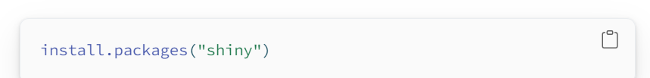
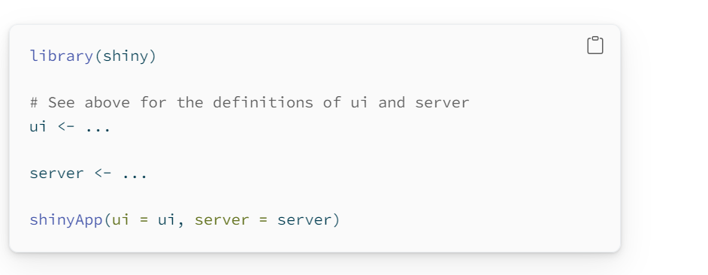
CODE & SYNTAX

Slide 11
Build a user interface

Slide 12
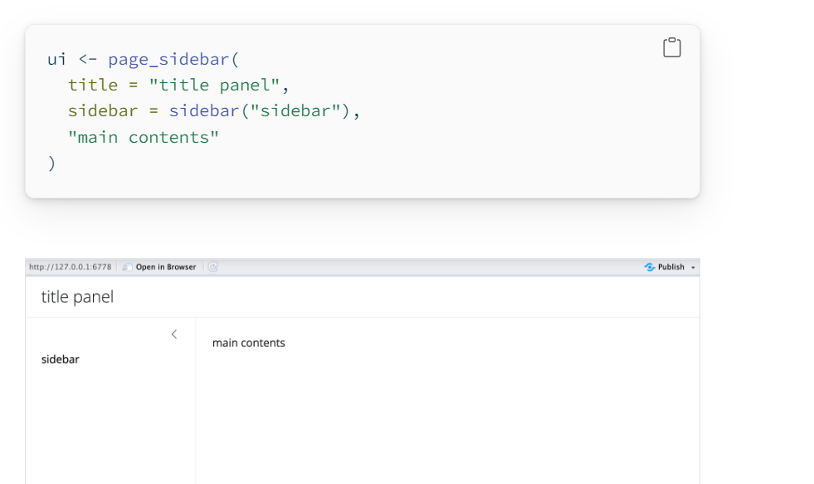
LAYOUT(pagesidebar)

Slide 13
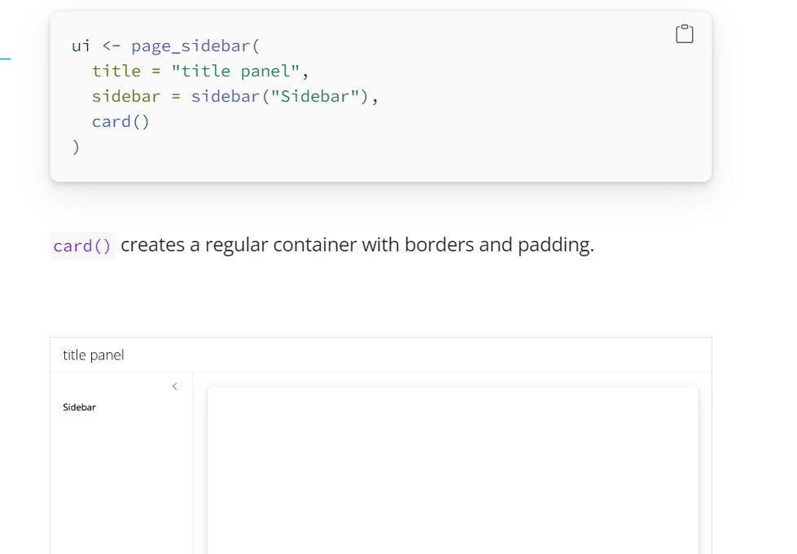

Slide 14
WIDGETS
Each widget function requires several arguments. The first two arguments for each widget are
A Name For The Widget: The user will not see this name, but you can use it to access the widget’s value. The name should be a character string.
A Label: This label will appear with the widget in your app. It should be a character string, but it can be an empty string "".
In this example, the name is “action” and the label is “Action”: actionButton("action", label = "Action")

Slide 15
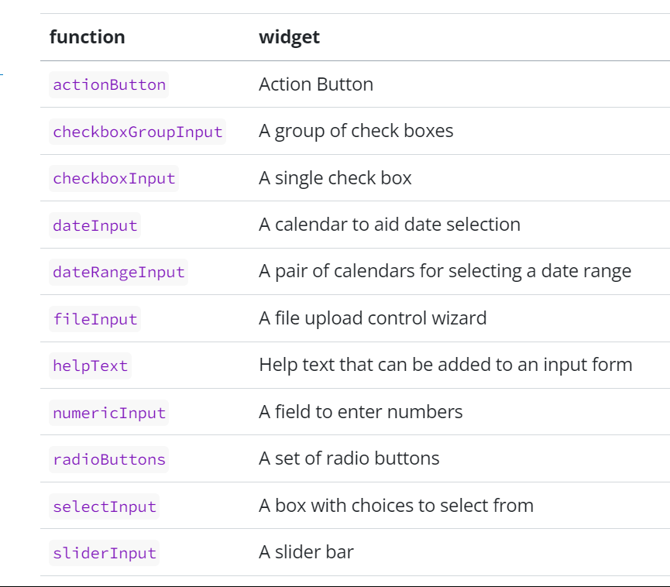

Slide 16
HANDS ON

Slide 17
CONCLUSION
RShiny emerges as a transformative tool in the realm of big data visualization and analysis. By bridging the gap between complex data and actionable insights, RShiny facilitates informed decision-making processes in real-time, thereby unlocking the true potential of big data. As organizations continue to grapple with the challenges of handling massive volumes of information, RShiny stands as a beacon of innovation, offering a dynamic solution that transcends traditional boundaries and paves the way towards a data-driven future.

Slide 18
THANK YOU

